Slide 1
Basic research and economic growth Working paper available on line at http://hdl.handle.net/1887/18636
Cornelis van Bochove

Slide 2
Overview
Growth Literature
The technology function: applied R&D and technology
The hypothesis function: basic research.
Return on applied R and D and basic research
Neoclassical Science policy

Slide 3
Current growth literature (Part of advanced macro economics)

Slide 4
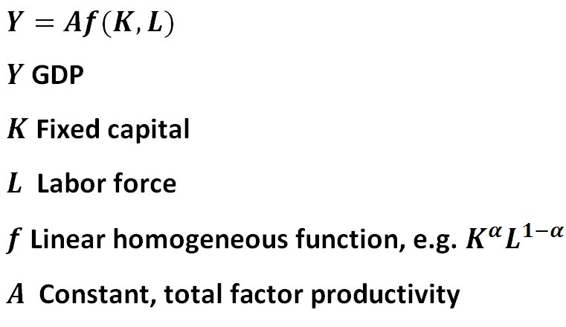
Growth Literature: production function
Growth of A: “Technological progress”

Slide 5
The neoclassical theory of economic growth
Robert Solow (1960): production function plus saving-based capital accumulation ≠ sustained per capita growth
Technological progress also needed (earned him the 1987 Nobel in economics; foundation of attention for innovation)
Exogenous (exponential) until 1990 (“Manna from heaven”).
From 1990 endogenous growth theory: tries to explain technological progress

Slide 6
Endogenous growth: basic model
Technological progress proportional to amount of R & D
There is a stock of knowledge (“Ideas”) that grows proportionally to amount of R&D.
Technological progress = growth of stock of knowledge
Then: constant level of R&D = constant rate of economic growth.
Higher level of R&D yields higher rate of economic growth.
Stock of knowledge in 2008 version of UN-EU System of National Accounts, R&D now officially investment
Nice for science ministers and research councils

Slide 7
Endogenous growth: the scale problem
But there is a problem: the scale problem
Bigger economy spends more on R&D. Thus higher growth rate.
Growing population or higher R&D productivity imply growing economy, hence more R&D spending and higher growth rate.
Thus more technological progress, still more spent on R&D, ……. , economy explodes

Slide 8
Billionaires galore

Slide 9
Solution of scale problem: dimishing returns
Knowledge accumulation progressively more difficult
Then growth of stock of knowledge no longer proportional to amount of R&D
Explosion vanishes, but growth too!
Only some very slow growth if population grows

Slide 10
Solution of scale problem: need for knowledge scale dependent
Most used mechanism: product diversity increases with scale, equal knowledge needed for all products
Growing number of products plus fixed amounts of R&D per product: total R&D grows
Relation between level of R and D and rate of growth is back
But, but, but

Slide 11
Problems of solution
Extreme fine-tuning: product diversity must grow at exactly the same rate as the economy, or else …; and very sensitive for unknown parameter values
Disaggregation of R&D extremely difficult. Recent effort at ETH to distinguish basic research complicated/artificial.
Strict relation between country size and product diversity?
Empirically: measurement tough and inconclusive (Donselaar´s recent dissertation)
The model is like Ashley and Pudsey
Won Britain’s got talent 2012, not because they danced most beautifully …

Slide 12
But because Pudsey can dance at all
Finance ministers know these problems. They don’t like dancing dogs

Slide 13
Stock of knowledge reasonable assumption?
Knowledge not cumulative, new results replace/ transcend old ones
No measurable/definable stock of knowledge like housing stock, capital stock, road network.
Knowledge no factor of production in traditional sense, stock-flow model does not work for knowledge/ technological progress
Can we generate endogenous growth without a stock-flow model of knowledge?

Slide 14
Alternative, Part 1: Technology and applied R&D

Slide 15
Trial and error
Technological progress is trial and error process
Solutions, ideas, possibilities tried out all the time.
Those that work best: retained/put into practice
Other ones/existing solutions: discarded/forgotten
Formally: accumulation replaced by repeated sampling and selection from a random distribution
Analogous to Kortum, Econometrica, 1997
I call this distribution the ‘Technology function’

Slide 16
The technology function
Many technologies to produce the same basket of goods and services
They differ in efficiency/productivity
Number of technologies smaller at higher productivity level: more ways to work inefficiently than efficiently.
Thus technological possibilities have random distribution that is skewed, with a long tail
Like Kortum, I use inverse power law (= Pareto distribution). Lots of those in scientometrics.

Slide 17
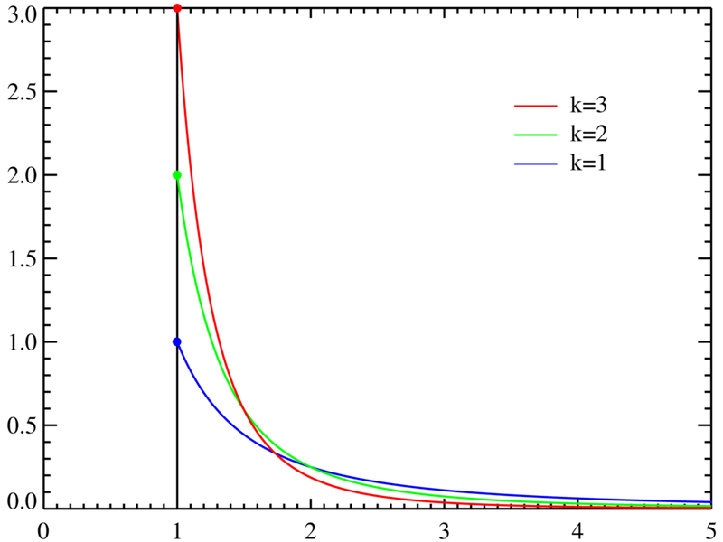
The Pareto technologyfunction
Shape everywhere the same
k is the power, low k, innovation easy

Slide 18
Pure trial and error (pre-industrial)
Applied R&D = sampling (search) from the distribution (“experimentation”), retaining the best result
Technological process then depends on sampling process
Simplest process: a-select trial and error until something better than current practice is found
Basis of pre-industrial innovation
The higher the level achieved, the more additional experimentation needed for further progress
Thus slow growth, and only if means for experimentation grow by population growth.
Accords with available very long term growth data.
Corresponds to diminishing returns case, but now with clear historical interpretation

Slide 19
Experimental learning
Next suppose that by experimentation you not just find better technologies, but also learn to experiment with greater chance of success.
Technology function the same, but lower boundary shifts upward as a consequence of the experiments

Slide 20
China and other transitionals
Learning by experimentation requires sufficient basic scientific knowledge.
Situation of transitional countries: China, India, Brasil, Japan until 1980.
There applications of experiments (including application of licensed and copied technologies) generate more means for further experiments, and
render those successful too, as lower boundary shifts upwards.
Thus double digit, explosive growth: Dagobert Duck
Until they catch up and run into lack of basic knowledge. Cf. Japan from 1980 on.
Remember Newton the alchemist: spent half his life on experiments we now know are pointless

Slide 21
Alternative, part 2: basic research

Slide 22
Basic research: the hypothesis function
Basic research is: developing hypotheses, testing whether they explain experimental results, retain the best and continue. A la David Deutsch
At every level of technology hypothesizing is needed until basic knowledge explains results of experiments and further experiments with lesser results can be avoided. No more looking for gold in test tubes.
I define a hypothesis function as the distribution of basic research hypotheses
Trial and error hypotheses development/testing until the explanatory power exceeds the current minimum of the technology function.
Then the minimum increases and the game starts again at a higher level.
For simplicity let shape of the hypothesis function also be Pareto with the same power k as the technology function
How fast can hypotheses be developed and tested? Assume:
proportionality with amount of basic R and D labor/spending;
fixed rate of learning of standard research worker. In every field the first hypothesis requires the same amount of work as in earlier fields, the next one a bit less, and so on.

Slide 23
Modern economic growth
This yields a nice and globally stable rate of long term growth.
Value depends on two opposing forces: technology power k and rate of learning in basic research.
If k is high (innovation is difficult), growth is lower.
If the rate of learning is high, growth is higher.
Growth boosted a bit by labor growth, but even if that is zero, per capita income still grows, due to the learning in basic research.
Conclusion: ‘scale free’ neoclassical endogenous growth without funny assumptions

Slide 24
Return on applied R and D and basic research

Slide 25
Return on research spending (1)
Growth rate does not depend on the proportions of income that are spent on physical capital, applied R and D and basic research.
Similar to a long standing result (Solow, 1956) in growth theory: rate of saving does not influence the growth rate.
But it does influence the level of income and consumption.
And this is the same for research.
Surprisingly easy to derive the rates of return once you have the model.
Caveat: our model is for the world or the OECD as a whole
They depend on the two parameters (technology power, rate of learning in basic research) that we do not yet know.
But they are not very sensitive to these unknown parameters.
Rather, they are very sensitive to the current levels of the rate saving, the applied R& D intensity and the basic R and D intensity.

Slide 26
Return on research spending (2)
And these we know!
For the rate of saving we may use 15 %, for applied R and 1.5 % and for basic research at most 0.5%. Then:
The return on applied R&D spending is about ten times that on physical capital investment and that on basic R &D about three times higher still
One euro extra applied R&D generates about 15 euro national income.
One euro extra basic research generates about 50 euro extra national income.
Hence: if the OECD governments spend one extra euro on basic research, they will receive about 25 euro extra taxes

Slide 27
Neoclassical Science policy

Slide 28
Neoclassical Science policy: free or targeted basic research (1)
Long term economic growth of OECD countries depends almost exclusively on basic research.
Therefore basic research policy is very important
First big question: should governments leave basic research alone or try to direct it to specific sectors?
This can be modeled by the allocation of research labor to the basic research fields

Slide 29
Neoclassical Science Policy: free or targeted basic research (2)
Free research: all basic research labor works for all technologies at the same time
Targeted research: compartmentalization so that they work mostly for a select number of technology fields
I have modeled the two extremes: completely free allocation and complete targeting (≈‘Topsectoren beleid’)
The latter halves the rate of economic growth

Slide 30
Neoclassical Science policy: effectiveness of basic research (1)
Rate of learning in basic research fundamentally determines economic growth
The main aim of science policy should be to raise this rate of learning. This means:
Open access to publications and data
Excellent high speed research networks
Ample research facilities (small and big), and easy access to them more important than more researchers!
Excellent training for young researchers (PhD’s)

Slide 31
Neoclassical Science policy: effectiveness of basic research (1)
But also: reduction of learning losses due to massive outflow of PhD’s and Post Docs: early tenure track selection.
Stimulation of independence of young talent (they learn faster and are quicker to choose the new approaches)
Defragmentation within universities, much easier multidisciplinary collaboration; reduction of within-university invoice culture
Probably many more things, let’s think about it.

Slide 32
Thank you very much!

