Slide 1
It’s the economy stupid! Physics and the EU Economy
Colin Latimer
Current Treasurer EPS
Former Treasurer IoP

Slide 2
When does jam become marmalade?
We continentals interpret the word “Europe” to include the British Isles : the British usually do not. I once saw, side by side, the French and English versions of the same book on birds. The French title was ”Les oiseaux Européens” the English, “Birds of Europe and the British Isles”. I hope…
HBG Casimir, IEE Lecture 1965

Slide 3
I have heard statements that the role of academic research in innovation is slight.
It is about the most blatant piece of nonsense it has been my misfortune to stumble upon
H B G Casimir
Research Director, Philips Laboratories.

Slide 4
Physics innovations for an advanced world
1. LASERS
1958 First Optical Maser
1973 First barcode scanner
1985 First CD/DVD
Today the laser industry is worth $6bn

Slide 5
Physics innovations for an advanced world
2. LCDs
1936 First patent
1968 First useful display
Over 80% of 200million TVs sold are LCDs
Current global market is over100bn

Slide 6
Physics innovations for an advanced world
3. MRI Scanners
1945 First NMR measurements
1980 First MRI image of a patient
Current global MRI market $5.5bn

Slide 7
Investing in Physics
[Such] research may be a bad private investment, as resulting commercial applications cannot be exploited exclusively by any one company, but a good investment for society because such developments are a public good
C H Llewellyn–Smith, former D-G of CERN

Slide 8
“One day, sir, you may tax it”
Michael Faraday, in reply to British Chancellor of the Exchequer Gladstone’s question “What use is electricity?” (1850)
Harvest of a Quiet Eye, IoP, 1977

Slide 9
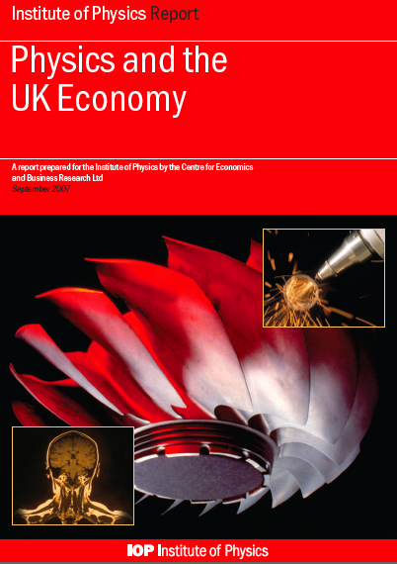
UK study

Slide 10
Physics Evaluation Procedure
Perform an objective statistical analysis of the contribution of physics to industry business
Use an independent consultancy firm, specialised in the treatment of business data (CEBR — Centre for Economics & Business Research, London, UK or Deloitte,MCS)
Statistics mainly coming from EUROSTAT, the statistical office of the EU gathering statistics from the EU Members States in different fields to compare countries & regions

Slide 11
Data sources
Use the NACE classification scheme (Nomenclature Générale des Activités Economiques dans les Communautés Européennes) as framework
Eurostat’s Structural Business Statistics (SBS)
Use also other information from bodies such as World Trade Organisation, United Nations, US Census Bureau, Japan Customs …

Slide 12
NACE codes
Within NACE codes 35-40 physics related sectors where there is a critical use of physics in terms of associated technology, expertise and skills have been identified.
Examples include:
Nuclear fuel processing, manufacture of electronic components, electrical equipment and motors, optical instruments and photographic equipment, telecommunications, aircraft and spacecraft manufacture of medical and surgical equipment, defence activities.

Slide 13
NACE codes continued
Physics based activities which are NOT INCLUDED within the NACE codes are largely non market services and activities. Thus for example education and health, sports and entertainment are omitted as well as national and European physics research facilities, including CERN and FOM.

Slide 14
IoP UK 2012 Deloitte report

Slide 15
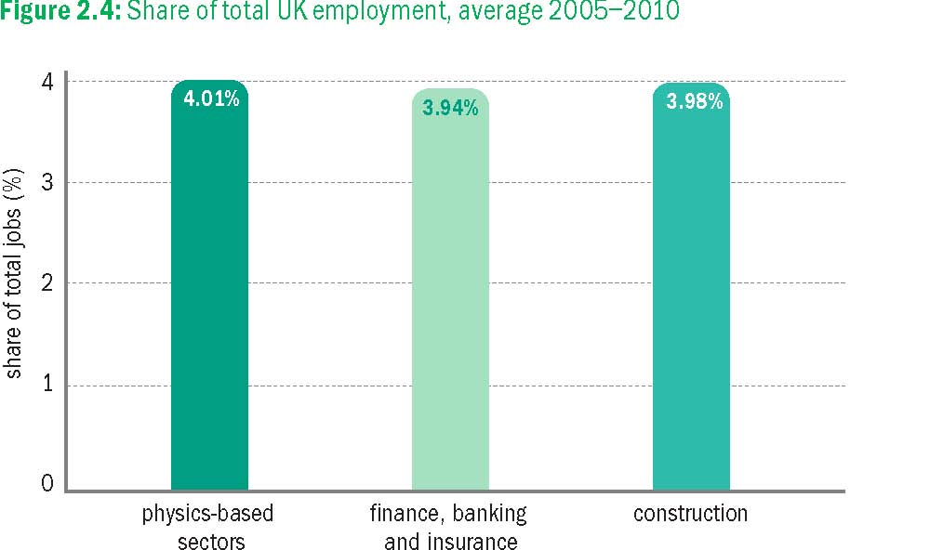
UK report - Jobs

Slide 16
UK report - turnover

Slide 17
UK report – turnover II

Slide 18
UK report - GVA

Slide 19
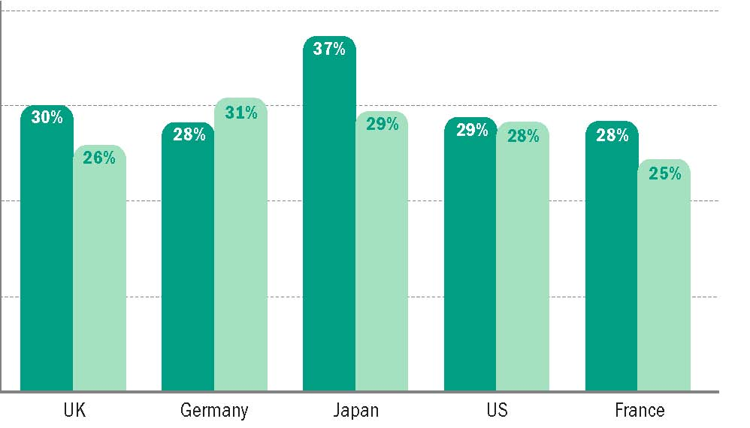
Exports and imports/exports

Slide 20
EPS CEBR report update
Statistics are available at the required level of detail from Euro Stat for 27 EU Member States, plus Switzerland and Norway.
Data is being collated for each country separately and EPS has access to the raw data for distribution purposes
Draft report received from CEBR January 1013

Slide 21
CEBR draft report
Conclusions are remarkably similar to, and compatible with, the UK (Deloitte) report

Slide 22
Figure 1: Turnover in physics-based industries, €bn 2011 prices

Slide 23
Share of total physics-based turnover in the EU-27, Norway & Switzerland; average 2007-10

Slide 24
Selected sectors’ shares of total EU turnover, 2008

Slide 25
Physics-based turnover per person employed, 2010, thousand €, EU-27 and Norway, Switzerland

Slide 26
EPS Final Report
The official launch will be in March/April 2013
The report will be a PR exercise for European physics and so it will be launched with numerous high publicity events involving as many members and societies as possible

Slide 27
Europe should become the most competitive and dynamic knowledge based economy in the world.
EU Commission, 2003

